Slide 1
TrackTec
Data Pass

Slide 2

TrackTec’s Solutions
Integrated Fuel and Fleet Management
Vehicle Maintenance
Cost Reduction

Slide 3

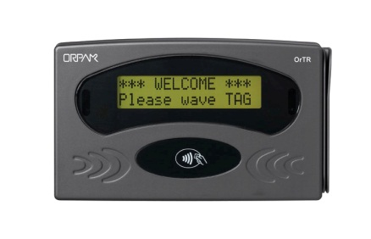

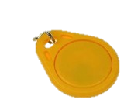
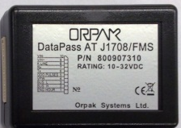
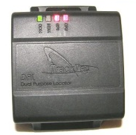
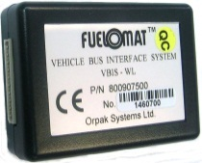
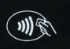
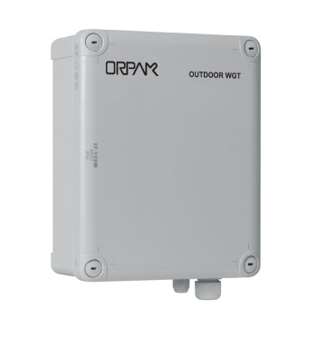
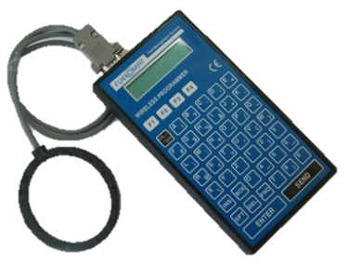
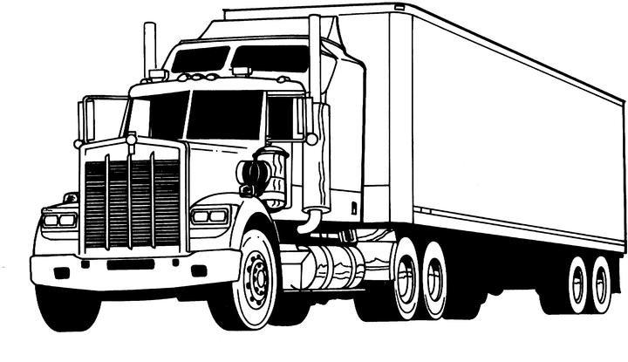
System Overview
Head Office
TrackTec BOS
Rompetrol HO
Approve fueling(2 stage)
Receive transactions
Reporting
←Send driver list
←Send transactions
Gas Station
↑AVL Online data
↓Approved drivers list
OrTR
Driver Tag
Vehicle
SiteOmat-W
RS232
Driver Tag
ICC
RS232
RS232
Tag reader
DPL
DataPass AVL
OBD CAN
OBD K-line
J1708/J1587
J1939
FMS
WGT
FuelOpass-EM

Slide 4
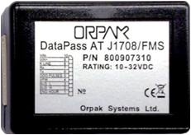
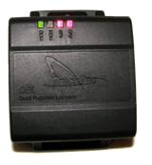
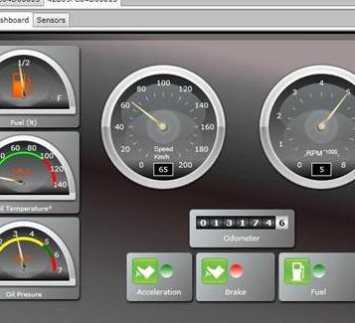
Client Benefit:
TrackTec + DataPass = Online CANbus data
TrackTec now has CANbus thanks to integration with Orpak’s DataPass
Data Integration
Complete
Fleet Management
Saves Money
Protects Assets
Location
Information
Driver
Behavior
Mechanical
information

Slide 5
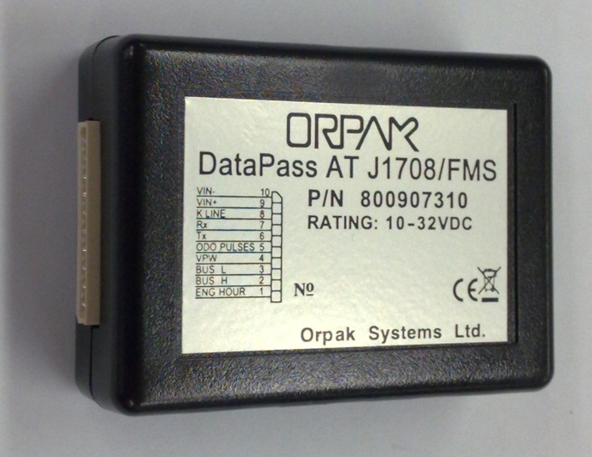
DataPass AVL
Data Pass is a small box that is being connected to the vehicles computer and transmits all the gathered data to the DPL
          Odometer
    Error Codes
  Main E.H.
  Aux1 E.H.
    Speed
          Aux2 E.H.
Idle Time
      Fuel Consumed
          Fuel Level
          Over Speeding
        PTO Timer
Over RPM

Slide 6

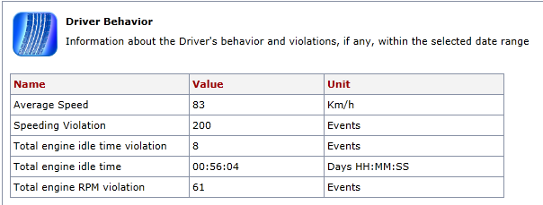
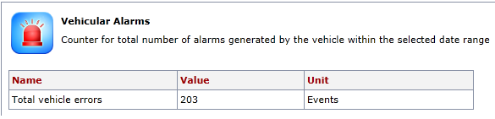
Available Reporting
Idle time
  Over speeding
    RPM Violations
      Speed
        Error codes

Slide 7
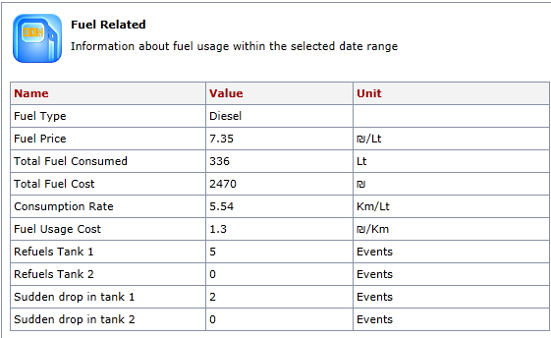
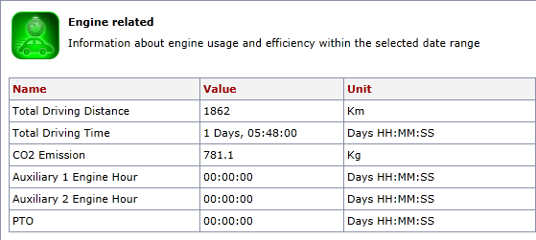
Available Reporting
Total fuel consumed*
Consumption Rate*
Refueling
Fuel theft
CO2 Emission
Auxiliary E.H.
PTO
* Protocol Type Dependent

Slide 8

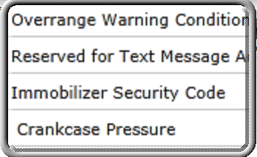
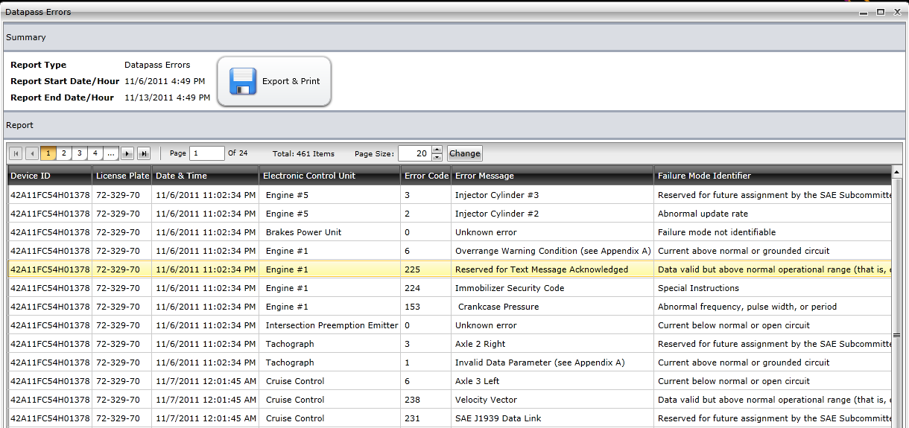
Engine Error Report
Engine error report can give the fleet manager,
understanding of the problem and save valuable
time and money in malfunction diagnostics.
Error code 225???

Slide 9
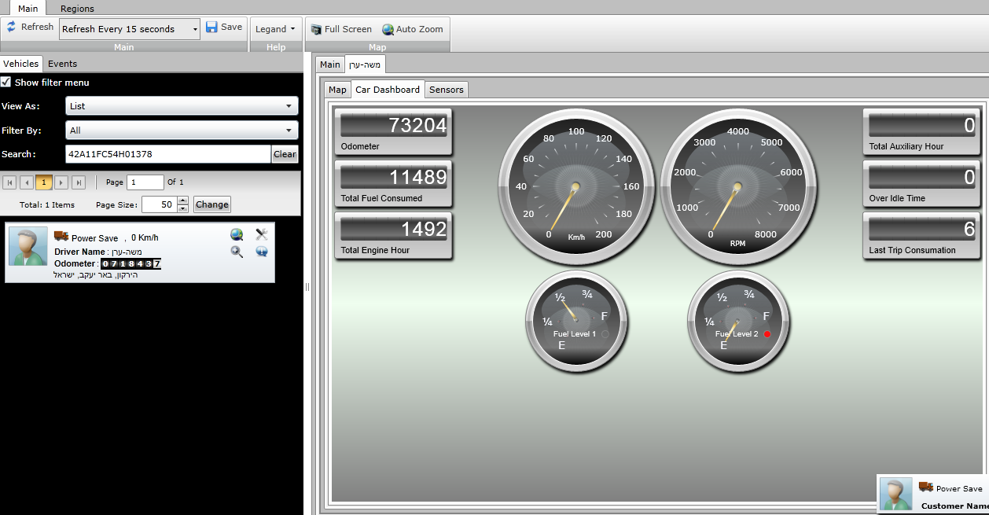
Dashboard
By adding a vehicle into the active map view,
the user can also view vehicle details in dashboard format
Speed.
Rpm
Fuel Level*.
Odometer.
Total fuel consumed*.
Total Engine Hour.
Total Auxiliary Hour*.
Over Idle Time.
Last trip consumption*.
Collected data from DP

Slide 10
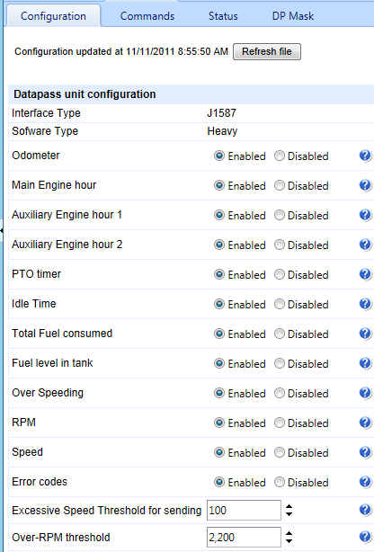
FULL BO SUPPORT
Odometer
Main EH
Auxiliary EH 1*
Auxiliary EH 2*
PTO timer
Idle time
Total fuel consumed*
Fuel level in tank*
Over speeding
RPM
Speed
Error codes
Over RPM
BO Administrator
has a user friendly
configuration tool.
You just need to click and the desired option
is Enabled/Disabled!!!

Slide 11
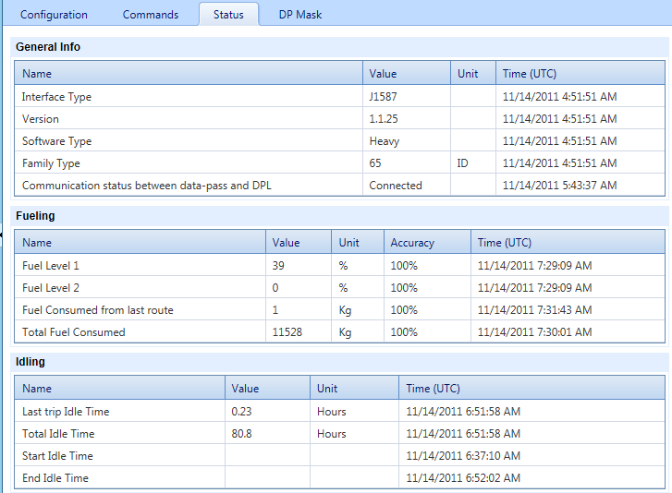
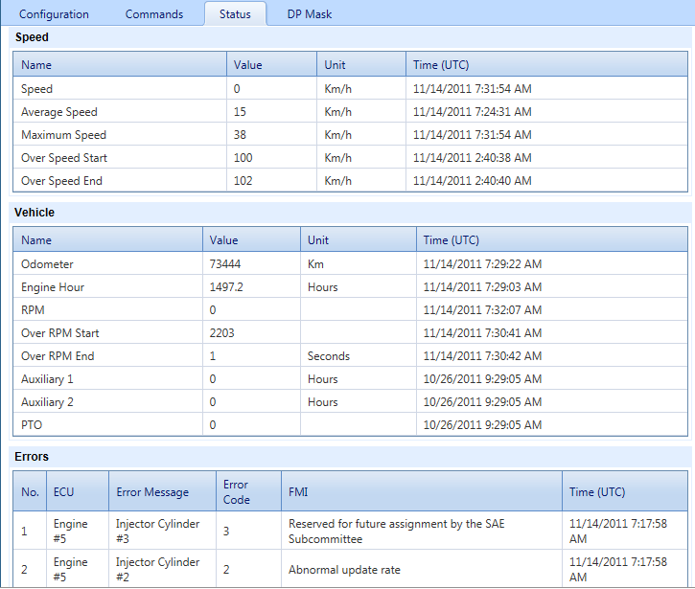






FULL BO SUPPORT
DP values are constantly being
updated , and available for
fleet manager…
Main Sections
Generals
Fueling
Idling
Speed
Vehicle
Errors

Slide 12
Thank you
31 Lechi Street  P.O. Box 1461  Bnei Brak 51114 Israel  Tel: +972-3-577-6777  Fax: +972-3-578-5977

